Slide 1
Digital Portfolio
STUDENT NAME: T.Yasmin
REGISTER NO AND NMID: 616545
DEPARTMENT: BSC Computer science
COLLEGE: Mahalashmi women's College of arts and science

Slide 2
PROJECT TITLE
Title : Student portfolio website
Subtitle:An organized presentation of academic achievements, skills and personal details

Slide 3


AGENDA
Problem Statement
Project Overview
End Users
Tools and Technologies
Portfolio design and Layout
Features and Functionality
Results and Screenshots
Conclusion
Github Link
3/21/2024 Annual Review

Slide 4

PROBLEM STATEMENT
Students finds it difficult to maintain and present their achievements in one place.A portfolio helps to organize academic achievements and personal details clearly for future opportunities.

Slide 5

PROJECT OVERVIEW
1. Showcase student ‘s achievements and skills
2. Provides organized academic and personal details.
3. Useful for higher studies and career opportunities .

Slide 6
WHO ARE THE END USERS?
1
1. Students -who create and maintain their portfolio.
2.Teachers- who guide and review their portfolio.
3.Employers-who can view the portfolio for hiring or internships.
4.College/Institution -who may use it for admission or evaluation.

Slide 7

TOOLS AND TECHNIQUES
1.HTML- to structure the web pages.
2.CSS- to style and design the portfolio.
3.Javascript - to add interactivity.
4.Codepen- for coding and testing.

Slide 8
POTFOLIO DESIGN AND LAYOUT
1.Header:Name and navigation menu.
2.About Me section: Photo and personal details.
3.Skills section:List of technical and soft skills.
4.Projects section:Cards or boxes showing project details.
5.Contact section: Email/ form for communication.
8

Slide 9
FEATURES AND FUNCTIONALITY
1. Easy navigation across sections.
2. Attractive design with responsive layout.
3. Showcase of academic details,skills and projects.
4. Option to update and maintain portfolio.
5. Contact information for future opportunities.

Slide 10
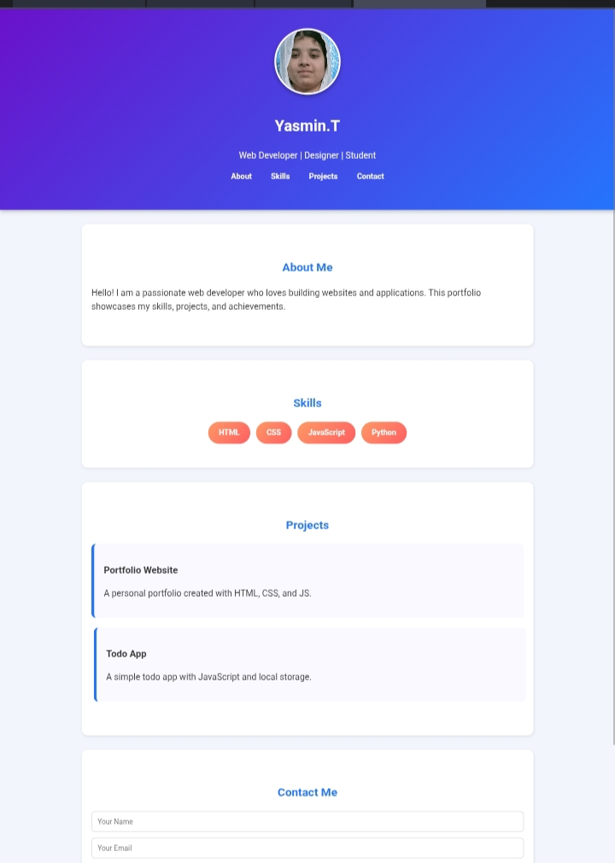

RESULTS AND SCREENSHOTS
3/21/2024 Annual Review
10

Slide 11
CONCLUSION
This portfolio showcases my skills, creativity and accomplishments in a structured and visually appealing way.It highlights my growth,key projects and the tools and techniques.I have mastered,reflecting my readiness to take on new challenge.
11

